Slide 1
PC based Application

Slide 2
Why
PC (IPC) is widely used in industries and business
User friendly
Powerful than embeded devices
More general purpose
Embedded devices need PC applications to
Control (operate)
Config (set parameters, report status/warning/error...)
Interactive (with people)

Slide 3
Structure
Upper and lower System
PC
(Upper System)
MCU/Embedded
(Lower System)
Communication

Slide 4
Example: DAQ Software
Data Aquisition
Retrive data from embeded system
Software in PC Platform
Interactive with user
Show data in curve or form
cooperate with lowersystem
Software in Embedded System
data sample from sensor
accept control command or config command from upper system
push data to upper system

Slide 5
Key part: Communication
Communication is how upper system to communicate with lower system
Tipical communication links include
Ethernet
Industry BUS
Serial Port
Serial Communication
Read/Write data bytes from/to serial port
Both ends should follow the same protocol

Slide 6
Serial Communication Protocol
Hardware protocol
BaudRate
Stop bits
Data bits
parity check (odd-even check)
Application protocol
How bytes are used to present the actual physical value
Using text may be simpler

Slide 7
Text based protocol
Text-based Vs Binary-based
Using text to present physical value is simple
Text can adapt to all hardware platforms
Text based protocol is low efficient, consuming more bandwidth
In DAQ system
using text to present the actual value
“0.01\n0.02\n0.03\n...”
how to present complex data like (t, data)
more complex data
JSON
XML
0.01
0.02
0.03
...
1, 0.01
2, 0.02
3, 0.03
...

Slide 8
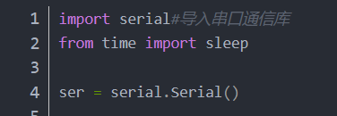
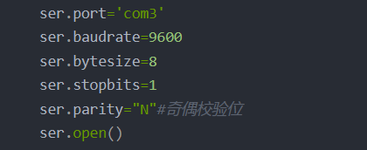
Serial communication in python
Using pySerial library
setup the serial communication parameters

Slide 9
methods provided by pySerial
ser.isOpen()：check if the port is open
ser.open() ：open the port
ser.close()：close the port
ser.read()：read 1 byte from the port
ser.read_all():read all bytes from the port
ser.write()：write to the port
ser.readline()：read a line from the port
ser.readlines()：read multi-lines
in_waiting()：wait for data come in
flush()：send out all the data
flushInput()：clear input buffer
flushOutput()：clear output buffer

Slide 10

Decode serial data
readline() to get the data in text form
parse the text into real data float(str)
If using complex form, using split() to split the data in text form before parse it.
print it on the screen (console)

Slide 11
Write your own PC based software
Write a python program to repeatedly read data from serial port
Shoud be able to process exception
port not open, port not exist, lower system is not ready, ...
Start lower system program first before run the program
Lower system can be implemented using Arduino
Arduino should write data to the serial port in the same text format
using: Serial.println(data)
Keep test and make it robust
Write a report and turn in as a homework

Slide 12
How to improve your program
Add GUI (Graphical User Interface)
With GUI, you can have more precise control to your program
with start, stop button to start/stop the DAQ precess
using curve to show the data instead of print to console
let user config the serial port at run time
visual feedback of the working status
More work will be need to design and implement the GUI
Using pyQt library or other library if you are familiar

